Slide 1
The value of a library of chunks: Compaction, Transfer, Creativity, and the Law of Serendipity
By Barbara Oakley, PhD

Slide 2
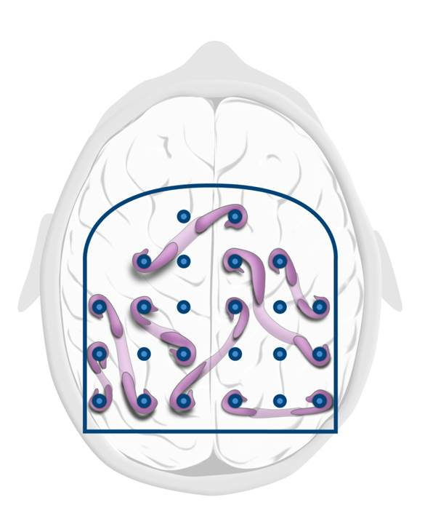
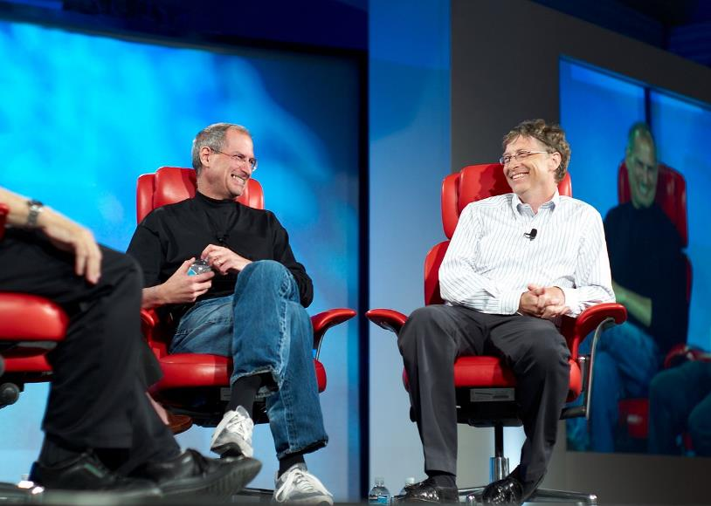

Slide 3
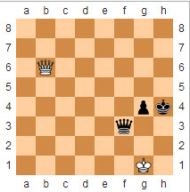
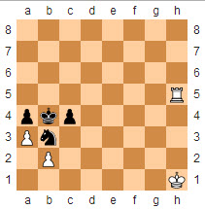
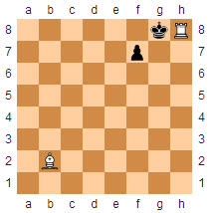
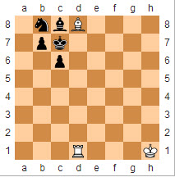
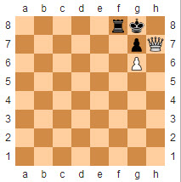
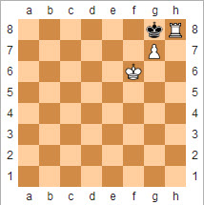
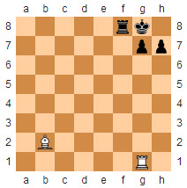
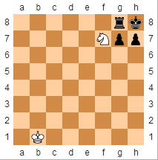
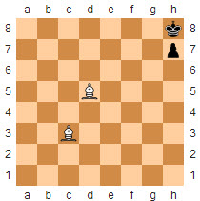
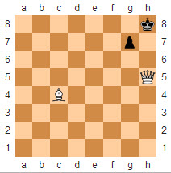
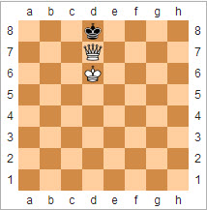
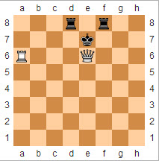

Slide 4
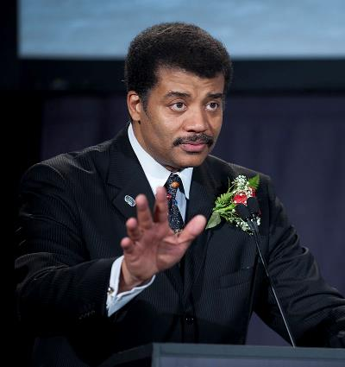



Slide 5
Transfer

Slide 7
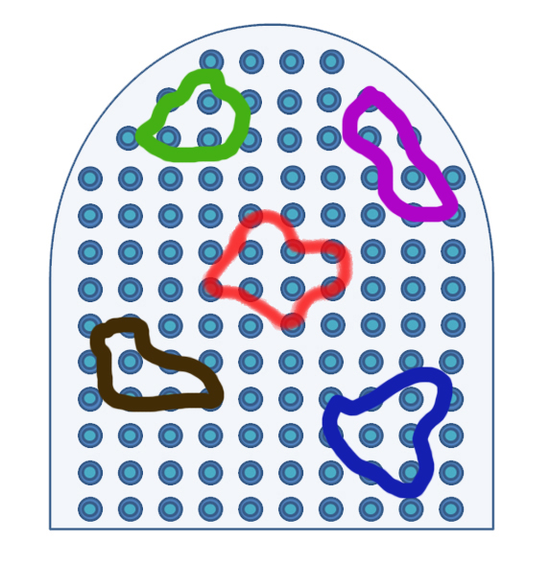

Slide 9
Sequential
Holistic (“global”)

Slide 10

The Law of Serendipity
Lady Luck favors the one who tries.

Slide 11
Illustration credits
Bill Gates and Steve Jobs at the 5th D: All Things Digital conference (D5) in 2007, Joi Ito from Inbamura, Japan http://en.wikipedia.org/wiki/Bill_Gates#mediaviewer/File:Steve_Jobs_and_Bill_Gates_(522695099).jpg
Chess patterns from http://en.wikipedia.org/wiki/Checkmate_pattern.
Guy Pratt, longterm Pink Floyd and David Gilmour bassist, http://en.wikipedia.org/wiki/Guy_Pratt#mediaviewer/File:Guy_Pratt_On_An_Island_Tour_Cropped.png, Deep Schism on Flickr (cropped by Heligoland) - Flickr http://www.flickr.com/photos/one_schism/284586820/
Steven Pinker, 2011, Rebecca Goldstein, http://en.wikipedia.org/wiki/Steven_Pinker#mediaviewer/File:Steven_Pinker_2011.jpg
Neil deGrasse Tyson, 2009 NASA/Bill Ingalls http://en.wikipedia.org/wiki/Neil_deGrasse_Tyson#mediaviewer/File:Tyson_-_Apollo_40th_anniversary_2009.jpg
Focused and diffuse pinballs, octopus and tentacles, ©Kevin Mendez, 2014.
Chunked ribbons © Barbara Oakley, 2014.
Pinball neural patterns ©Barbara Oakley, 2014.
Chunked pinball library with focused and diffuse modes , ©Kevin Mendez, 2014.
Man in the Mustang, ©Kevin Mendez and Philip Oakley, 2014.
Sequential versus more holistic thinking processes, ©Barbara Oakley, 2014.
Lady Luck, ©Kevin Mendez, 2014.

Slide 12
Recommended reading
Bransford, John D, A. L. Brown, R. R. Cocking, M Suzanne Donovan, and JW Pellegrino. "How People Learn." Washington, DC: National Academy Press, 2000.
Cooper, Graham, and John Sweller. "Effects of Schema Acquisition and Rule Automation on Mathematical Problem-Solving Transfer." Journal of Educational Psychology 79, no. 4 (1987): 347.
Gobet, F., and N. Charness, eds. Chess and Games. edited by K. Anders Ercisson, Neil Charness, Paul Feltovich and Robert R. Hoffman, Cambridge Handbook on Expertise and Expert Performance: Cambridge University Press, 2006.
Gobet, F., and G. Clarkson. "Chunks in Expert Memory: Evidence for the Magical Number Four… or Is It Two?". Memory 12, no. 6 (2004): 732-47.
Gobet, F., P.C.R. Lane, S. Croker, P.C.H. Cheng, G. Jones, I. Oliver, and J.M. Pine. "Chunking Mechanisms in Human Learning." Trends in Cognitive Sciences 5, no. 6 (2001): 236-43.
Gobet, Fernand. "Chunking Models of Expertise: Implications for Education." Applied Cognitive Psychology 19, no. 2 (2005): 183-204.
Guida, A., F. Gobet, H. Tardieu, and S. Nicolas. "How Chunks, Long-Term Working Memory and Templates Offer a Cognitive Explanation for Neuroimaging Data on Expertise Acquisition: A Two-Stage Framework." Brain and Cognition 79, no. 3 (Aug 2012): 221-44.
Ischebeck, A., L. Zamarian, M. Schocke, and M. Delazer. "Flexible Transfer of Knowledge in Mental Arithmetic--an Fmri Study." [In eng]. NeuroImage 44, no. 3 (Feb 1 2009): 1103-12.
Johnson, Steve. Where Good Ideas Come From. NY: Riverhead, 2010.
Kounios, John, and Mark Beeman. "The Aha! Moment: The Cognitive Neuroscience of Insight." Current Directions in Psychological Science 18, no. 4 (2009): 210-16.
Mastascusa, Edward J., William J. Snyder, and Brian S. Hoyt. Effective Instruction for Stem Disciplines. San Francisco, CA: Jossey Bass, 2011.
Rocke, A.J. Image and Reality. Chicago, IL: University of Chicago Press, 2010.
Simon, H.A. "How Big Is a Chunk?". Science 183, no. 4124 (1974): 482-88.
Simon, H.A., and W.G. Chase. "Skill in Chess: Experiments with Chess-Playing Tasks and Computer Simulation of Skilled Performance Throw Light on Some Human Perceptual and Memory Processes." American Scientist 61, no. 4 (1973): 394-403.
Simonton, Dean Keith. Scientific Genius [in English]. NY: Cambridge University Press, 2009.
Solomon, Ines. "Analogical Transfer and 'Functional Fixedness' in the Science Classroom." Journal of Educational Research 87, no. 6 (1994): 371-77.

